Slide 1
Design Thinking
Identifying Stake Holders’ Insights
Group 07

Slide 2
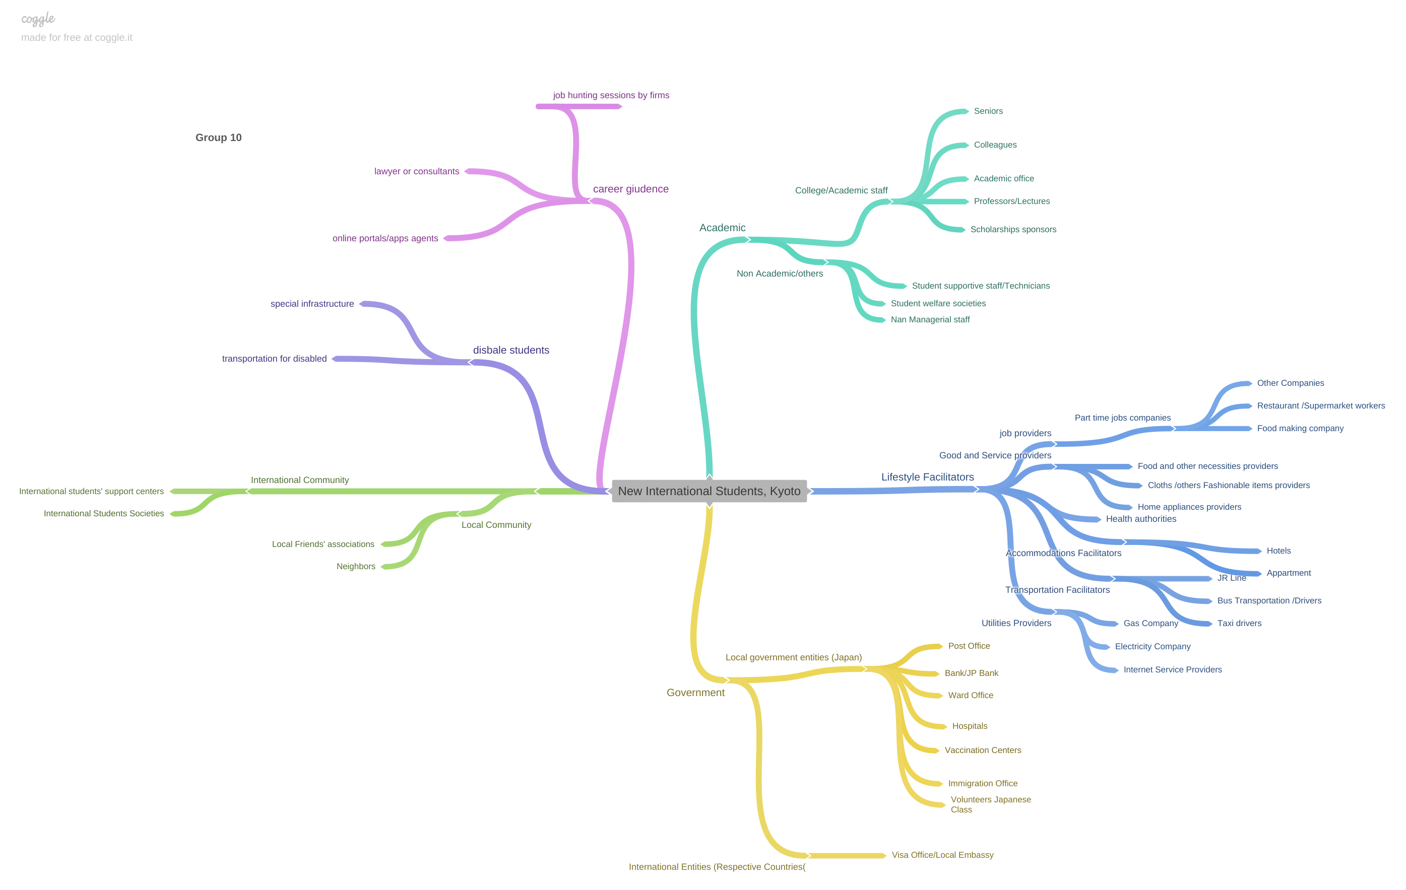
Stake Holders’ Map

Slide 3
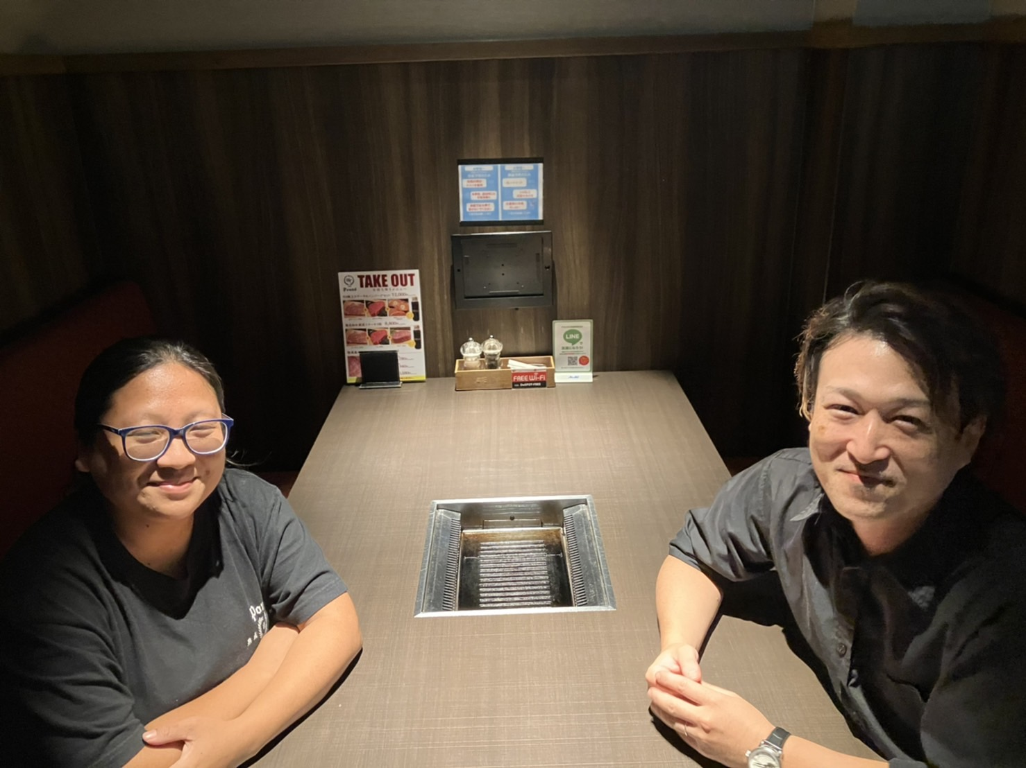
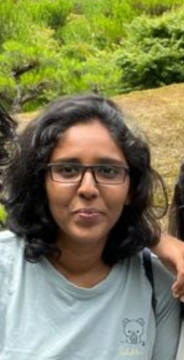
Selected Stake Holders to get Interviews
Manager
Japanese Citizen
Senior Student . KCGI
Name : Enmitsu
Restaurant Manger .Japanese
Name : Yuka saida
Phd Student , Volunteer Japanese
Narmada from Sri Lanka
Specialized in Mathematics
Following Masters at KCGI ,2nd Semester Student,
Living in Senbon Marutamachi Kyoto

Slide 4
INSIGHTS – OBSERVED THROUGH MANAGER
Kyoto local people are happy to have international students in Kyoto as well all over the Japan.
They appreciate the hard work of international students who are really doing good with their work and studies in the same time.
As per local person of Kyoto he suggested to have look and visit of historical sides of Kyoto which is one of the must do activity in Kyoto, which is very helpful to learn and get closer with Kyoto.
He advised to do more hard work in Japanese language.
He is satisfy with international students even though they are in learning phase of language and different working environment. He believes that no one is perfect b born, all are learning on the journey of life, so he is glad to help them who are really willing to learn different language and culture.

Slide 5
INSIGHTS - OBSERVED THROUGH JAPANESE CITIZEN
International friends around me also tried to adapt themselves to Japanese foods. But one of the biggest problems for me was that processed foods in Japan don't give so much information about the contents.
Not contents →ingredient
In my opinion, Japanese foods can be more diverse. Also I hope that imported foods can be accessed more easily.
Language problem and covid 19 became barrier when completing studies and it was difficult to complete it smoothly.

Slide 6
INSIGHTS – SENIOR STUDENT OF KCGI
Significance of learning IT and that will open up lots of opportunities in career life as the future will be more relied with IT.
University plays a vital and main role of helping students who are new to Japan until she/he gets settled by finding Apartments, part time jobs directing to do other activities etc. Seniors assistance also appreciated
It is better to have sound or basic knowledge in Japanese in order to maintain day today activities smoothly .
If you can it is better to share the accommodation with your friend at least you get settled down that really help overcome difficulties face during the initial phase.
Got surprised Japanese Culture and Technology due to the fact Japanese has totally different culture , so in order to make your life easier and comfort you should have to adjust with the culture.
Enable to make new friends different counties and share their values and thoughts.

Slide 7
INSIGHTS – SENIOR STUDENT OF KCGI - CONTINUED
Kyoto city is rich with seasonal changes so there are a lot breathtaking places to visit and collect memories and relax your mind
Japanese people value more very calm and peaceful environment always and also their traditional lives so you have to behave without making disturbances to others.
Proper balance between Study and working life and due to online conducting lectures make it more and more easier to maintain balance. Priority given to the studies is more important. Be punctual for everything you do.
Reading book which you love , Hanging out with friends, listing to music , Dancing, drawing pictures, playing instruments help you to get out of study and work stress

Slide 8
THANK YOU!

